Slide 1


Staff Wellness Education & Resources
Notes:
These materials were developed by a team of people who included staff of opioid treatment programs, clinically trained experts, and researchers. The effort was supported by the National Institute On Drug Abuse of the National Institutes of Health under Award Number R61DA059889
For more information, please contact the MPACT study team at MPACTStudy@arizona.edu.
We highly recommend that this information be presented to staff vs. directly sent to staff along with these notes. This will allow staff to engage in conversation and questions/answers about the topic and material.

Slide 2

Focus
Trauma and symptoms
Vicarious (work related) trauma and why this is important
Trauma Treatment
Help for YOU

Slide 3

What is Trauma?
Trauma results from an event, series of events, or set of circumstances experienced by an individual as physically or emotionally harmful or life threatening.
Trauma can have lasting, adverse effects on the individual’s functioning and mental, physical, social, emotional, or spiritual well-being.
SAMHSA: U.S. Substance Abuse and Mental Health Services Administration
Notes:
Advice to clinic presenter or educator:
If you are presenting this to a staff group, you may want first to ask (before presenting this slide): “Write down 2 or 3 things that define what trauma is to you.” Based on the group size you could either discuss ideas as a group or ask individuals to share the ideas with a person sitting next to them.
After displaying the slide, note the following: This definition is from a framework developed by a working group of researchers, practitioners, trauma survivors, and family members convened by the U.S. Substance Abuse and Mental Health Services Administration (SAMHSA). This agency also provides regulatory oversight of substance use disorder treatment in this country.
Trauma refers to both experiencing a traumatic event and the psychological, emotional, and physiological symptoms that result from the event. The acute and long-term symptoms of trauma are called traumatic stress.

Slide 4
Potentially Traumatic Events
Abuse | Loss | Injury/Disruption | Chronic Stressors
Emotional Sexual Physical Intimate partner violence Witnessing violence Bullying Cyberbullying | Death Abandonment Neglect Separation | Natural disaster Accidents Terrorism War | Poverty Racism Chronic Illness or Invasive medical procedures Community trauma Historical trauma Family/relational stress or disfunction Institutional trauma
Notes:
These are examples of traumatic events. You may have thought about them when thinking about the definition of trauma. As you can see, there is a wide range of events that potentially cause trauma.
It may also help to know that
Trauma can be caused by events that the individual doesn’t remember, such as events that occurred in early childhood.
Trauma can be caused by events that are well-intentioned and necessary, such as medical procedures.
Trauma can be caused by an event that didn’t happen to the person but to a group that someone identifies closely with—as in slavery or the Holocaust or the genocide of the Native American people.
And, while the immediate focus might be on a recent event, the individual’s reaction to that event may be affected by earlier experiences.
Over time, chronic stressors can accumulate to cause trauma. Many people experience multiple traumatic experiences over their lifespan. AND trauma can be thought of differently by different cultures and communities. Symptoms may also be unique to particular cultures.

Slide 5
Trauma Is Common
About 70% of U.S. adults have experienced a potentially traumatic event at least once
Up to 20% of people who experience a potentially traumatic event develop ongoing symptoms or PTSD
Nearly 1 in 6 experience 4 or more Adverse Childhood Experiences (ACEs)
Risk for PTSD is especially high after interpersonal traumas including sexual assault (49%) and physical assault (around 32%)
Adverse Childhood Experiences (“ACEs”) have lasting effects on physical and emotional health
About 61% of adults experience at least one Adverse Childhood Experience (ACE) such as violence, abuse, neglect, or caregiver substance misuse
Notes:
Note to presenter:
Please briefly discuss what is on the slides and in the boxes. Be sure that the audience understands that “ACEs” refers to Adverse Childhood Experiences. PTSD means Post Traumatic Stress Disorder. ACEs include abuse, neglect and household/family challenges such as divorce.
What we know is that people experience trauma differently. For example, on average, women are twice as likely to develop post traumatic stress disorder, “PTSD”, as men. But men may be more likely to develop PTSD after certain types of traumas.
We also know that people who are sexual and gender minorities are at even higher risk of experiencing traumatic events in their lives (due to violence against them) and to experience symptoms.

Slide 6
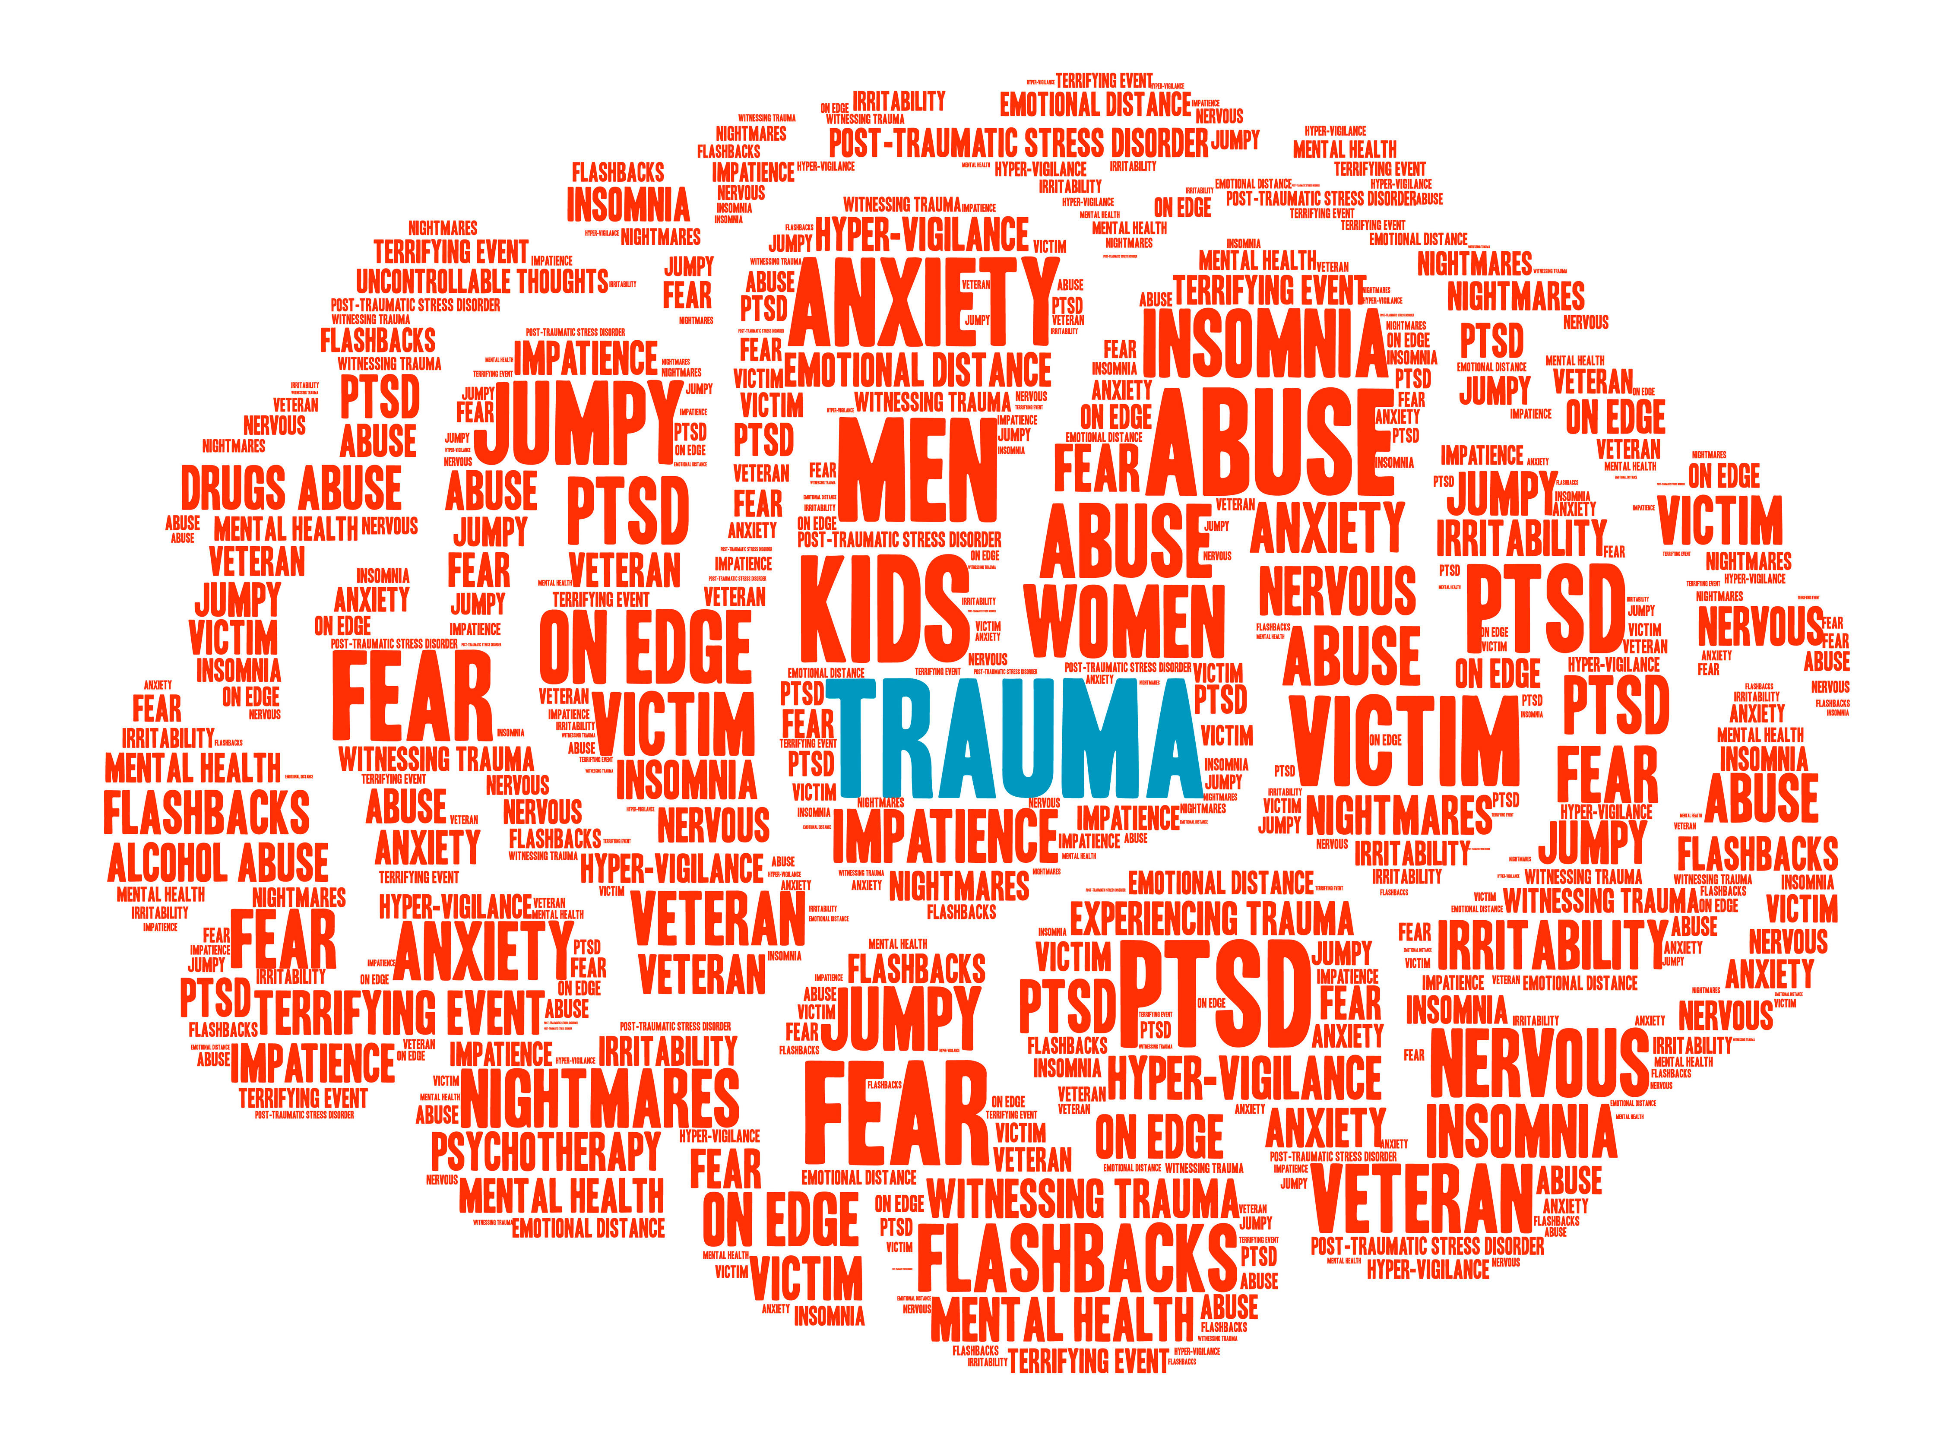
Basic Assumptions About Trauma
Traumatic events can overwhelm an individual’s capacity to integrate experiences in the normal way
Traumatic experiences can be split off from normal functioning and experience
This is a protective and adaptive response to abnormal experience
Even when we are not actively thinking about or remembering traumatic experiences, they are inaccessible to consciousness, they have the power to shape an individual’s daily functioning and behavior
A person may alternate between:
Functioning as if the trauma never occurred
Functioning as if the trauma is still occurring
Notes:
Educator/group facilitator advice when presenting this slide:
Engage the group: Take a moment to identify 3 or 4 examples of trauma symptoms.
And (second conversation): Can you think about how these symptoms may have been really protective during the traumatic event? For example, many people will try to avoid things that remind them of the trauma. This can be ‘protective”’ and help prevent re-experiencing and re-traumatization.
Explain ‘avoidance’ – This can be really concrete such as avoiding people, places, or things (triggers) or more of a mental process such as shutting off, shutting down, changing the subject, being a bit spacy….zoning out….. These are all examples of avoidance.
Trauma symptoms can also be expressed as emotions such as anger, irritability, fear and depression.
Depending upon the setting, this can be a group exercise (sharing to the group), in a dyad or thoughtful reflection as an individual.

Slide 7
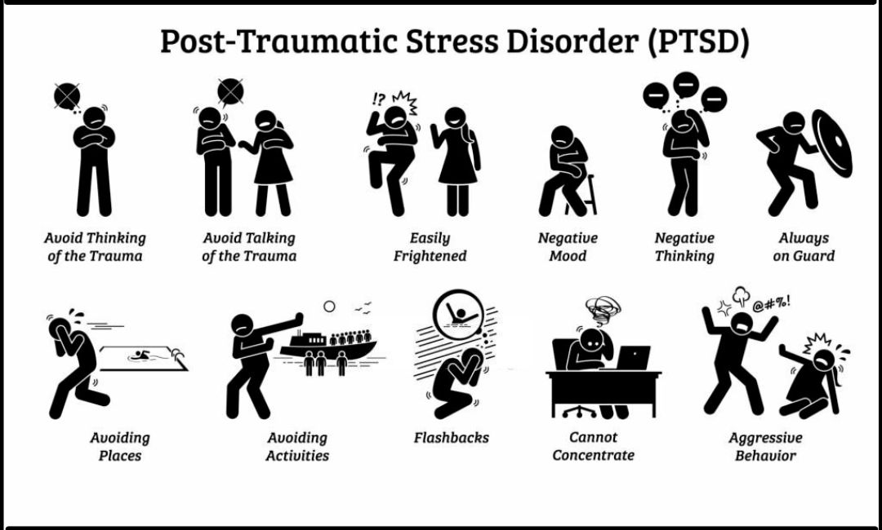
Notes:
Understanding what trauma is and how it affects us and others (through symptoms) is important for our overall health, the health of our communities and even our patient care.
It is important to understand symptoms of trauma so that we know how we are doing and how to take care of ourselves and support those we care about.
Trauma and PTSS can affect both patients and providers. We often think about our patients and not often ourselves. What we want to appreciate is that both patients and providers experience trauma.
Something to remember is this: “The interpretation guides the intervention.” What does this mean? It means that how we see symptoms of our clients and our own selves (how we interpret them)-- as bad/problematic, or survival mechanism and resilience and adaptive – these conceptions guide what we do about them (how we address them or even if we address them).

Slide 8
One’s culture can play a role in the interpretation and perception of a traumatic events and the trauma symptoms they experience
Culture determines acceptable responses to trauma and shapes the expression of distress
Culture influences how one assigns meaning to an event or symptom
Culture influences how people convey traumatic stress through behavior, emotions, and thinking
Trauma is not the same for everyone. Culture may matter
Notes:
Notes to the presenter
Culture means the shared values and experiences of a community. It can be a church, an ethnicity, a nation, it can be neighborhood, work environment, group of people that share experiences that define them.
A person's culture can inform their interpretation, perception, meaning, collective and individual beliefs about a traumatic event, what trauma symptoms are, engaging in help-seeking behaviors, and support.
Using a sociocultural lens to view trauma allows for a non-ethnocentric view of trauma and trauma symptomatology. Taking this approach to conceptualizing trauma is part of having cultural humility.

Slide 9
Culture can be a source of strength or resilience that contributes to safety and wellbeing.
At the same time, however, certain cultural norms and practices (sexism, xenophobia) can put members at risk for harm and greater trauma responses
Nightmares can be categorized as a posttraumatic stress symptom, but in some cultures, this is a form of ancestral communication and serves as spiritual communication
Cultural Diversity in Symptom Expression and Recognition
Notes:
Despite a somewhat universal biological response to trauma cross-culturally, the biopsychosocial experience of trauma is influenced by cultural factors and, therefore, the reactions to traumatic stress can vary. For example, nightmares are associated with trauma and are/can be recognized as a posttraumatic stress symptom. Yet there is an assumption that the categories created in one cultural context, Western, can be applied in another. But if we look at a person experiencing nightmares and their culture, there may be variations in Western trauma symptomatology recognition due to the meaning of nightmares in that person’s culture (Patel & Hall, 2021; Treatment US, 2014).
[educator/presenter] suggestion to engage the group about cultural expressions or understandings of trauma or symptoms they might know about.
Note to Presenter: You may want to share other examples of how trauma symptoms may be expressed differently based on cultural norms.
For example, individuals from Eastern and Latin American cultures are more likely than Western-born individuals to report somatic symptoms including body aches, shortness of breath, and sensations of body heat following trauma. Not understanding and appreciating cultural variations in symptom expression may lead to misdiagnosis and incorrect treatment referrals.
There are two resources that you may want to consult when thinking about additional examples. These are Resource 1 and Resource 2 on the MPACT dashboard for trauma navigation.

Slide 10

VICARIOUS TRAUMA
Vicarious Trauma is work related trauma.
When a provider repeatedly hears about and processes their clients’ traumatic experiences, it can result in real trauma symptoms in the provider.
Notes:
Notes to Presenter
It is likely that the staff will not know about vicarious trauma as a term, but might well understand concepts of burnout. Review the slide definitions and then engage the group in conversation.
Before you present this slide,
Engage the staff while training them by encouraging them to identify strengths or limitations they experience through the day.....make it direct and short so they do not consume the timing of the training but feel heard, seen and validated because they are important and their roles are critical.
Ask the group: What comes to mind when you think about the idea of vicarious trauma?
Vicarious trauma is more than simply understanding what another person has gone through. Over time when a provider has deep empathy for their patient, the patient’s traumatic experiences can result in real trauma symptoms in the provider.
You may want to consider offering additional informational resources such as this from SAMHSA: https://www.samhsa.gov/resource/dbhis/indirect-traumatization-professionals-working-trauma-survivors-providers

Slide 11

Notes:
So let’s pause for a moment: What could happen when providers feel stress over the work they are doing with patients?
Think to yourselves for a moment. Think about our own workplace. Our own clinic. How would we know if we or others are experiencing vicarious trauma?

Slide 12

Impact of Vicarious Trauma
Inner transformation.
Changes in the way we think about the world around us. Feelings of not being safe or having control.
About our patients. Reduced trust. Unable to connect with patients.
About our work: Reduced motivation, efficacy, empathy, self-esteem, self-perception, intimacy, safety and trust. Burnout.
Notes:
As you look at this information, you may recognize these symptoms in your patient population as well as in your own life (whether in friends, family, coworkers or even yourself). It is not strange to think about stress in the workforce because the work can be stressful. There are many professions that involve situations that can be stressful.
Let’s stop and think to ourselves about the work we are doing. What makes this work stressful?
[note to educator/presenter] You can ask the group for discussion, continue with individual reflection or invite the group to speak in dyads.
Studies have found that providers of substance use disorder treatment have higher prevalence of trauma exposure and trauma symptoms than the general population.
For example, these studies found that 56% of substance abuse counselors reported posttraumatic stress symptoms (PTSS) and 19% met full diagnostic criteria for PTSD. (compared to rates of between 2-8% in the U.S. adult population)

Slide 13
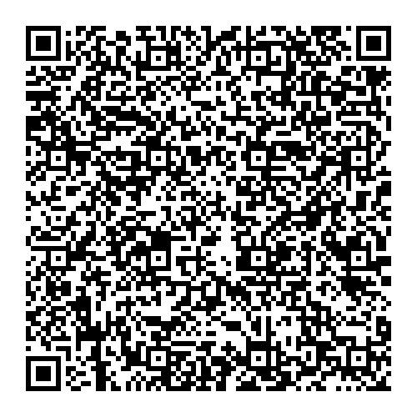

Trauma Outcomes among OTP Staff in 3 AZ Clinics, 2023 (N=40)
Meyerson BE, Linde-Krieger LB, et al. Addic Sci Clin Pract 2024
History
90% report at least one traumatic event
58% ≥ 4 traumatic events
Interpersonal violence & assault were common
Symptoms
63% had clinically significant PTSD symptoms
73% report vicarious trauma symptoms
Much higher than population
Higher than First Responders
Vicarious Trauma
82.5% say job exposes them to traumatized clients
65% say job involves distressing experiences
Burnout
Notes:
A recent study among three OTP clinics found that the vast majority of staff (90%) had histories of trauma exposure. This would not be surprising given the shared history of substance use disorder. In this particular group of OTP staff, almost half (47.5%) had lived substance use disorder experience. Almost one third (27.5%) had lived opioid use disorder experience. We know that people with substance use histories also have trauma histories. This may be your experience.
Having trauma history does not mean that we have trauma symptoms. In fact, having a trauma history may be protective for us in this work – allowing greater empathy to the trauma of our patients.
What we do worry about is when our trauma symptoms become such that they affect our life.
What you see in this slide too is that in this group of OTP staff, 63% had clinically significant post traumatic stress symptoms. That means that they would benefit from trauma treatment. Further, 73% identified having symptoms related to the work (vicarious trauma).

Slide 14

Staff Trauma Symptoms (PTSS and Vicarious Trauma)
Beliefs and Orientations toward the work & the patient (cognitive change)
Readiness to change
“Rules” vs. flexible patient orientation
Sense of workplace safety
Quality of Treatment
Notes:
Not only are symptoms of stress hard on us as people, but as providers, it also can affect our patient care and ultimately our patients.
First, we know that close personal alignment with patients (often because we share similar histories) can also cause secondary stress (or vicarious trauma).
We also know that this stress – PTSS or Vicarious Trauma/Work Related trauma/Secondary Stress – may impair the way we work with patients (or “therapeutic functioning”). Examples might include:
Blurred therapist and patient emotional boundaries, especially with patients who have high prevalence of trauma.
Altered ways of thinking, such as beliefs, and assumptions about ourselves, the world around us, the work and our patients. This can lead to changes in functioning
Ultimately stress symptoms can compromise patient care

Slide 15

Impact of Vicarious Trauma on Quality of Work Life
Symptoms of vicarious trauma can disrupt our beliefs and perceptions around safety and control
Low morale or even burnout
Decreased empathy and compassion satisfaction
Notes:
Safety and control involves beliefs about how safe we feel where we are; how much control we feel we need with people around us and even our patients to make us feel safer.
Compassion satisfaction is fulfillment in our work and care for our patients

Slide 16

Trauma-Focused Therapy
Seeks to understand how traumatic experiences affect our individual mental, emotional, and physical well being.
Seeks to help strengthen coping strategies, process trauma, transform emotions, assist adaptation of healthy perspectives
Unique to the person - many options
Therapy is focused on the trauma
Evidence-based
Notes:
Trauma can be treated with medication or psychotherapy. There is an emerging evidence based about effective treatments and even patient preferences for them. Trauma-focused therapy is a form of psychotherapy that involves different therapy techniques to help a person process their experiences.
It is important that One Size Does Not Fit All. There is no one treatment that is right for everyone, as post-traumatic stress affects individuals differently.
Therefore, what works for one person may not work for another, and that is OK.
Exploring various therapies and finding one that resonates with you allows for a more personalized approach, addressing your specific needs, goals, and circumstances.

Slide 17

Four Common Therapeutic Approaches to Treat Trauma
Creates a safe and trusting environment to explore and process experiences.
Cognitive Behavioral Therapy (CBT)
Eye Movement Desensitization and Reprocessing (EMDR)
Prolonged Exposure (PE)
Cognitive Processing Therapy (CPT)
Notes:
Here is a description of each of the therapies:
Cognitive behavioral therapy (CBT) focuses on the relationships among thoughts, feelings, and behaviors; targets current problems and symptoms; and focuses on changing patterns of behaviors, thoughts, and feelings that lead to difficulties in functioning.
Cognitive processing therapy (CPT) is a specific type of cognitive behavioral therapy that helps patients learn how to modify and challenge unhelpful beliefs related to the trauma.
Prolonged exposure (PE) is a specific type of cognitive behavioral therapy that teaches individuals to gradually approach trauma-related memories, feelings, and situations. By facing what has been avoided, a person presumably learns that the trauma-related memories and cues are not dangerous and do not need to be avoided.
Eye Movement Desensitization and Reprocessing (EMDR) is a structured therapy that encourages the patient to briefly focus on the trauma memory while simultaneously experiencing bilateral stimulation (typically eye movements), which is associated with a reduction in the vividness and emotion associated with the trauma memories

Slide 18
Key Messages for Trauma Recovery
Key Messages for Trauma Recovery
It is not happening now
You are safe
You are good
You have a future
Notes:
These messages are not only helpful for your patients and may also be helpful to you.
1. It is not happening now
The trauma is over. It is in the past. You are here in the present.
2. You are safe
You are capable of maintaining safety with the help of your support system. You are worthy of care and protection.
3. You are good
Whatever you have experienced, whatever mistakes you have made, whatever you have had to do to survive, you are a good, strong person who can contribute to your community.
4. You have a future

Slide 19

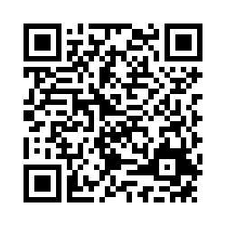
This information is developed to help you so that you can have a fulfilling work life and provide excellent patient care here at the clinic.
Follow the QR code to learn more about your own stress and what you could do about it
Notes:
The next steps are up to you. Here are some recommendations.
You can learn more about your own experiences and see if you have symptoms.
You can learn more about trauma and vicarious trauma
You can learn more about strategies to help you feel better
You can also find resources for trauma treatment through your employee benefits program and from resources we will provide.

Slide 20

Feeling Stressed?
Scan here to learn more about it and to get some help.
Notes:
Communication option for staff emails, posters/flyers, or training slides.

Slide 21
Feeling the effects of work?
Go to: https://tinyurl.com/MPACTResourceWellness
OR
Scan the code to anonymously access more information and resources.
Notes:
Additional option for staff messaging or flyer/poster

Slide 22
